Slide 1
Azure Times #129
August 9, 204

Slide 2
Security & Identity

Slide 3
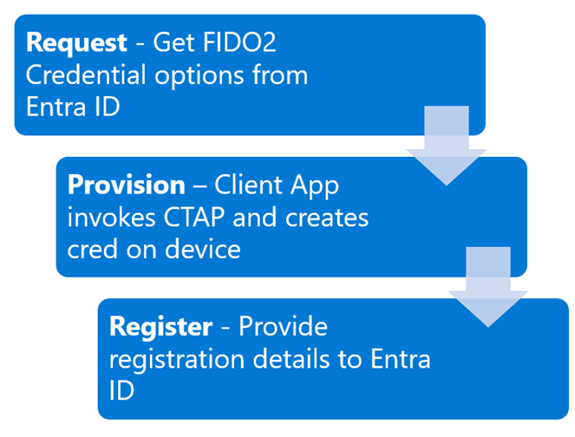
Security & Identity Updates
Public preview: Microsoft Entra ID FIDO2 provisioning APIs
Microsoft Entra ID FIDO2 provisioning APIs that empowers organizations to handle this provisioning for their users, providing secure and seamless authentication from day one.
The APIs allow keys to be pre-provisioned for users, so users have an easier experience on first use.

Slide 4
Management & Governance

Slide 5
Management & Governance Updates
Generally Available: Operator and CRD support with Azure Monitor managed service for Prometheus
Azure Monitor managed service for Prometheus now supports CRD-based configs for scrape jobs to collect metrics from workloads running in AKS cluster. With this new update, configuring Managed Prometheus will deploy the Pod and Service Monitor custom resource definitions to allow to create own custom resources. This is similar to the OSS Prometheus Operator, and allows for easy configuration of scrape jobs in any namespace, eliminating the need to update the common ConfigMap in the kube-system namespace.

Slide 6
Compute

Slide 7
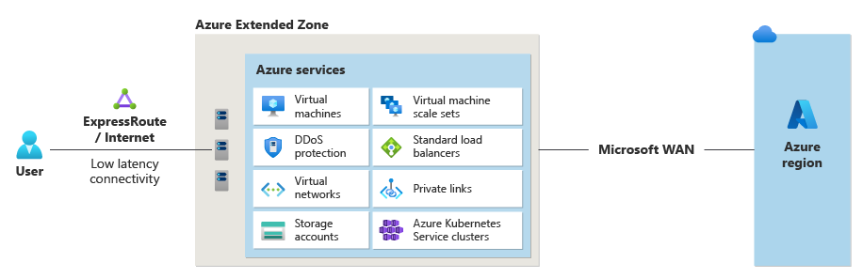
Compute Updates
Public Preview: Los Angeles - Azure Extended Zones
Azure Extended Zones are small-footprint extensions of Azure placed in metros, industry centers, or a specific jurisdiction to serve low latency and data residency workloads. It supports virtual machines (VMs), containers, storage, and a selected set of Azure services and can run latency-sensitive and throughput-intensive applications close to end users and within approved data residency boundaries.
The control plane for these services remains in the region and the data plane is deployed at the Extended Zone site, resulting in a smaller Azure footprint.
Service category | Available services
Compute | Azure virtual machines (general purpose: A, B, D, E, and F series and GPU NVadsA10 v5 series) Virtual Machine Scale Sets Azure Kubernetes Service
Networking | Azure Private Link Standard public IP Virtual networks Virtual network peering ExpressRoute Azure Standard Load Balancer DDoS (Standard protection)
Storage | Azure managed disks Azure Premium Page Blobs Azure Premium Block Blobs Azure Premium Files Azure Data Lake Storage Gen2 Hierarchical Namespace Azure Data Lake Storage Gen2 Flat Namespace Change Feed Blob Features - SFTP - NFS
BCDR | Azure Site Recovery Azure Backup

Slide 8
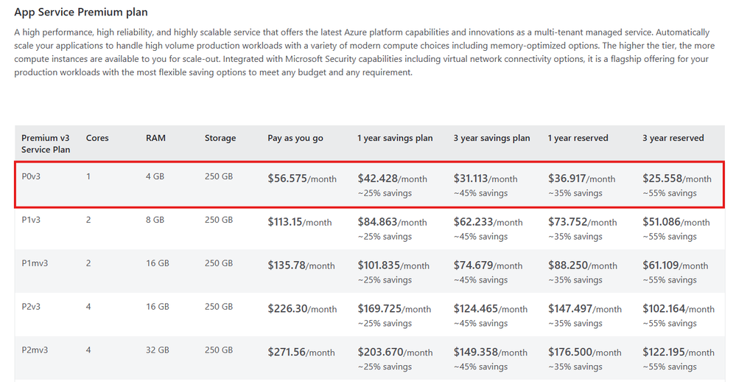
Compute Updates
Retirement: Azure Synapse Runtime for Apache Spark 3.1 disablement
Disablement for Azure Synapse Runtime for Apache Spark 3.1 was announced on August 29th, 2024. MS recommend to upgrade Azure Synapse Runtime for Apache Spark 3.1 workloads to Azure Synapse Runtime for Apache Spark 3.4 - Azure Synapse Analytics
Announcing lower pricing for Azure App Service Premium P0v3 to help build and modernize AI apps
The entry-level Premium plan known as P0v3 is now available at a significantly lower price, making it even more convenient and affordable to get started in AI apps journey using favorite platform-as-a-service.
Premium v3 is the latest generation of Azure App Service that offers high performance, high scalability, and high reliability as a multi-tenant managed service. Unlike previous generation plans such as Premium v2 or Standard, Premium v3 plans include commitment-based savings over one and three years that significantly lower the monthly bills, while delivering more powerful compute resources.
Bring Your Own NSG to Microsoft Azure Red Hat OpenShift Clusters
Traditionally, when creating an ARO cluster, the ARO Resource Provider (RP) would generate a dedicated resource group containing cluster-specific resources, including Network Security Groups (NSGs).
ARO now offers the ability to attach own preconfigured NSG to the ARO cluster subnets. This NSG resides in base or VNET resource group, giving full control over its rules throughout the cluster's lifecycle.
Limitations:
NSGs must be attached to both master and worker subnets before cluster creation.
The feature can only be enabled during cluster creation, not for existing clusters.
Manual updates to NSG rules are required when creating new Kubernetes LoadBalancer services or OpenShift routes.
-Certain rules must be added to ensure the service can run its operations. Please see the documentation for these rules.

Slide 9
Compute Updates
Windows 365 GPU-enabled Cloud PCs now generally available
GPU-enabled Cloud PCs are now generally available for Windows 365 Enterprise and Frontline editions. Users can now handle advanced workloads—that were traditionally limited by the constraints of local hardware—in the cloud with increased speed and efficiency. Sensitive data and high-value digital assets can be processed and stored securely in the cloud, mitigating the risks associated with local storage.
The following configurations are available today through Windows 365 Enterprise and Frontline editions:
Windows 365 GPU Standard
Windows 365 GPU Super
Windows 365 GPU Max

Slide 10
Storage & Data

Slide 11
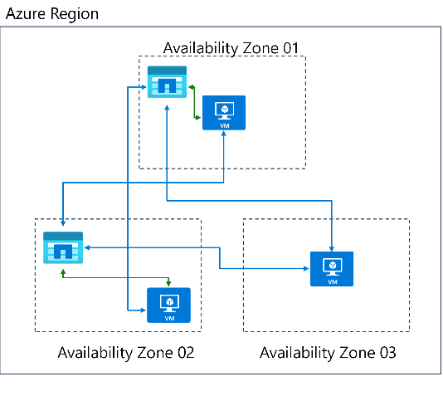
Storage & Data Updates
Generally Available: Azure NetApp Files cross-zone replication
Cross-zone replication feature allows to replicate Azure NetApp Files volumes asynchronously from one Azure availability zone (AZ) to another within the same region. It uses SnapMirror® technology similar to the Azure NetApp Files cross-region replication feature and Azure NetApp Files availability zone volume placement feature, to replicate data in-region across different zones; only changed blocks are sent over the network in a compressed, efficient format.
To failover to the destination volume in such situations, breaking of peering relationship and mounting of destination volume must be setup by the user. This feature minimizes the amount of data required to replicate across the zones, limiting data transfers required and shortens the replication time, so you can achieve a smaller Restore Point Objective (RPO). Cross-zone replication doesn’t involve any network transfer costs, and hence it is highly cost-effective.
Cross-zone replication supports three replication schedules: 10 minutes, hourly, and daily.
For the replication schedule of 10 minutes, the typical RPO is less than 20 minutes.
For the hourly replication schedule, the typical RPO is less than two hours.
For the daily replication schedule, the typical RPO is less than two days
Note:
The 10-minute replication schedule isn't supported for large volumes using cross-zone replication.
You can’t use cross-zone replication and cross-region replication together on the same source volume.
The replication destination volume is read-only until you fail over to the destination zone to enable the destination volume for read and write.
Azure NetApp Files replication doesn't currently support multiple subscriptions; all replications must be performed under a single subscription.
Cross-zone replication does not support cascading and fan in/out topologies.

Slide 12
Storage & Data Updates
Unplanned Failover | Planned Failover
After an unplanned failover the storage account is converted to Locally Redundant Storage (LRS) and the secondary region becomes the new primary region. | After a planned failover the storage account remains Geo Redundant Storage (GRS) while the secondary region becomes the new primary region, and the primary region becomes the new secondary region.
Once an unplanned failover is initiated the operation begins immediately. Writes that were pending replication to the secondary region (made after the Last Sync Time) will potentially be lost. Users can utilize their Last Sync Time to determine the recovery point of their storage account. | Once a planned failover is initiated the first step is replicating pending writes (writes made after the Last Sync Time) to the secondary region. As a result, the Last Sync Time is caught up and there should be no data loss.
Primary use case: a storage related outage in the primary region. | Primary use case: to test the Failover workflow or a non-storage related outage in the primary region.
Can be used when the primary storage endpoint becomes unavailable (there is a storage related outage on the primary region). | Works while the primary and secondary storage endpoints are available.
Public Preview: Customer Managed Planned Failover for Azure Storage
Planned Failover provides the ability to swap your geo primary and secondary regions while the storage service endpoints are still healthy. As a result, a user can now failover their storage account while keeping geo-redundancy and with no data loss or additional cost. Users will no longer need to reconfigure geo-redundant storage (GRS) after their planned failover operation which will save them both time and cost. Once the planned failover operation is completed all new writes will be made to your original secondary region, which will now be your primary region.
There are multiple scenarios where Planned Failover can be utilized including:
Planned disaster recovery testing drills to validate business continuity and disaster recovery.
Recovering from a partial outage that occurs in the primary region where storage is not impacted.
A proactive solution in preparation of large-scale disasters that may impact a region.

Slide 13
Storage & Data Updates
Generally Available: Azure NetApp Files zone volume placement enhancement – Populate existing volume
Azure NetApp Files availability zone volume placement feature lets deploy new volumes in the availability zone of choice, in alignment with Azure compute and other services in the same zone. With this enhancement it is possible to obtain and, if desired, populate previously deployed, existing volumes with the logical availability zone information.
Populating existing volumes will facilitate data protection as it is a pre-requisite for supporting replication across availability zones.

Slide 14
Integration

Slide 15
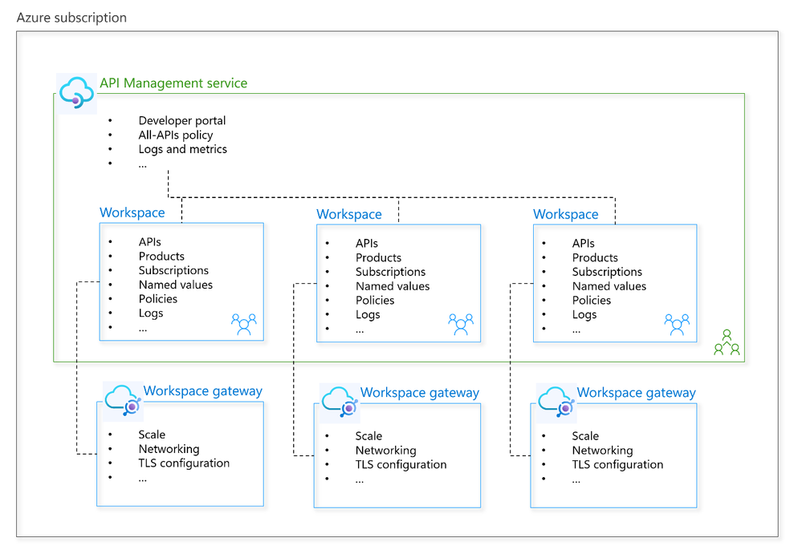
Integration Updates
Announcing General Availability of Workspaces in Azure API Management
Workspaces bring a new level of autonomy to API teams, enabling them to create, manage, and publish APIs faster, more reliably, securely, and productively within an API Management service. By providing isolated administrative access and API runtime, workspaces empower API teams, while allowing the API platform team to retain oversight with central monitoring, enforcement of API policies and compliance, and publishing APIs for discovery through a unified developer portal.

Slide 16
DevOps & IaC & Automation

Slide 17
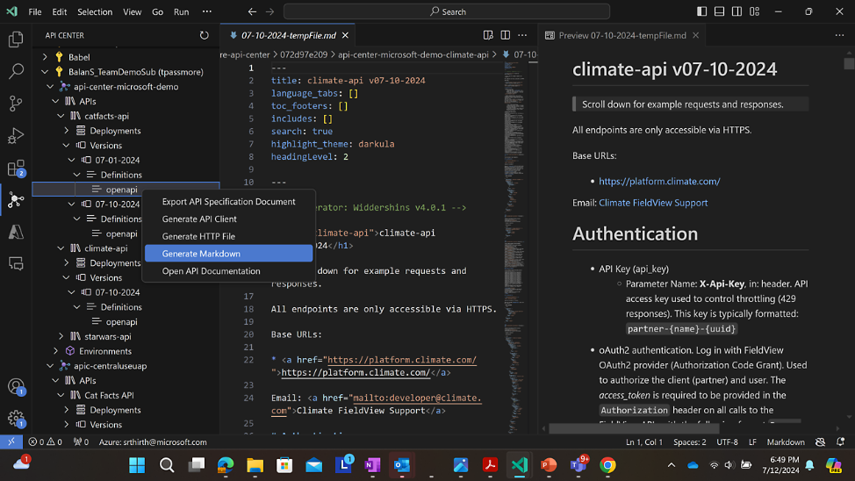
DevOps & IaC & Automation
Public Preview: Pre-release version - Azure API Center Visual Studio Code extension now adding a pre-release version
Azure API Center Visual Studio Code extension enables developers to build, discover, try, and consume APIs in Azure API Center.
Generate OpenAPI specification file from API code: Developers can now use the power of GitHub Copilot with the Azure API Center extension for Visual Studio Code to create an OpenAPI specification file from API code.
Generate Markdown: Developers can now generate the markdown documentation for any API in API center.

Slide 18
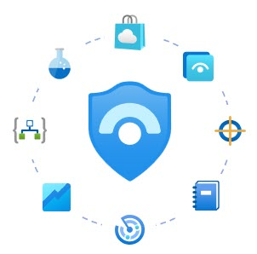
DevOps & IaC & Automation
Microsoft Sentinel All-In-One now available for Azure Government
A new improved version of Sentinel All-In-One is now released. It includes:
Create a resource group
Create a Log Analytics workspace
Enable Microsoft Sentinel on top of the workspace
Set the workspace retention, daily cap and commitment tiers if desired
Enable UEBA with the relevant identity providers (AAD and/or AD)
Enable health diagnostics for Analytics Rules, Data Connectors and Automation Rules
Install Content Hub solutions from a predefined list
Enable Data Connectors from this list:
Azure Entra ID
Azure Entra ID Identity Protection
Azure Activity
Dynamics 365
Microsoft 365 Defender
Microsoft Defender for Cloud
Microsoft Insider Risk Management
Microsoft PowerBI
Microsoft Project
Office 365
Enable analytics rules (Scheduled and NRT) included in the selected Content Hub solutions
Enable analytics rules (Scheduled and NRT) that use any of the selected Data connectors

Slide 19
DevOps & IaC & Automation
Announcing Public Preview of Managed DevOps Pools (MDP) for Azure DevOps
A new feature of Azure DevOps that enables dev teams or platform engineering teams to quickly spin up custom DevOps pools that suit team’s unique needs. It combines the flexibility of Scale Set agents and the ease of maintenance of Microsoft Hosted agents.
Hosted on your behalf
Time spent in Management
Specific Pools
Private Networking
Bring your own Image
Stateful Agents
DevOps Billing
Scalable
Name Reservation on Azure Container Registry
Azure Container Registry (ACR) will update its behavior regarding the deletion and re-creation of registries. ACR will prevent the reuse of a subdomain name, e.g. abc123.azurecr.io, for a period after the resource is deleted. This updated behavior enhances security and prevents subdomain takeovers by automatically reserving registry names during the creation of the ACR resource, without requiring any additional action or configuration from customers.
Once a resource name is reserved, it remains reserved from the moment of creation and throughout an extended period following the deletion of the resource (referred to as a cooldown period). During this cooldown period, subscriptions not associated with the original Azure AD tenant that created the resource will be unable to use the same name for a new registry.

Slide 20
Information

Slide 21
Information
Azure Times GitHub Repo

Slide 22
Questions

